Slide 1

HYPOTHYROID PREDICTION
Guide: Maddirala Syam Kumar, M.Tech.,
Roll Number | Team Member Name
17471A0581 | Bandi Jaya Sri
17471A0580 | Jandhyala Sai Lakshmi Bharathi
17471A05B5 | Naraparaju Sri Vyshnavi
17471A0590 | Shaik Roshini

Slide 2
Contents
Abstract
Introduction
Data preprocessing-Need and Steps
Feature Selection Techniques
Algorithms
Comparision of Algorithms
Output Screens
Conclusion
Future Scope
Online References

Slide 3
Abstract
The project proposes supervised machine learning for Hypothyroid Prediction
This uses comparative analysis of machine learning algorithms for finding the best fit model for construction
A model that predicts hypothyroid disease using lab reports
An application to predict Thyroid based on machine learning model

Slide 4
Introduction
Hypothyroidism occurs when our body doesn’t produce enough thyroid hormones.
The thyroid is a small, butterfly-shaped gland that sits at the front of our neck.
It releases hormones to help our body regulate and use energy.
Hypothyroidism affects women more frequently than men.
It commonly affects people over the age of 60, but can begin at any age.
It may be discovered through a routine blood test or after symptoms begin.
In this project we developed a predictive analytic model using Random Forest Classifier Algorithm applying SMOTE technique using RFECV for feature selection to get a best accurate model by comparative analysis of various machine learning algorithms

Slide 5
Data Preprocessing
What and Why Data Preprocessing?
Data Preprocessing Steps
Real-world data is often incomplete, inconsistent, and/or lacking in certain behaviors or trends, and is likely to contain many errors.
So we use Data Preprocessing, in-order to improve the model accuracy
Data preprocessing technique involves transforming raw data into an understandable format.
COLLECT THE DATASET
IMPORT LIBRARIES
LOAD THE DATASET
FIND MISSING DATA
REMOVE OUTLIERS
CLASS BALANCING USING SMOTE
SPLITTING DATASET INTO TEST AND TRAIN SETS
FEATURE SELECTION

Slide 6
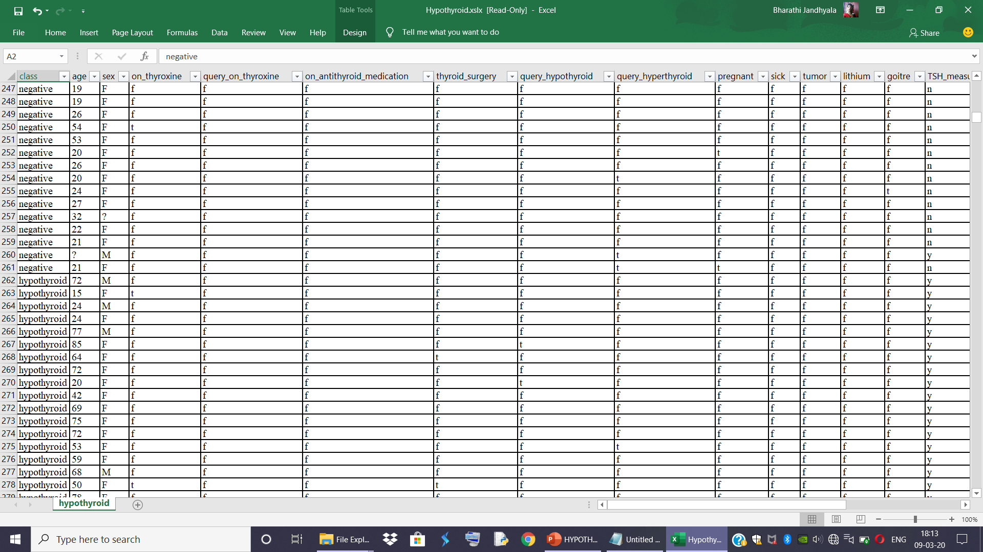
Dataset Snapshot-First Half

Slide 7
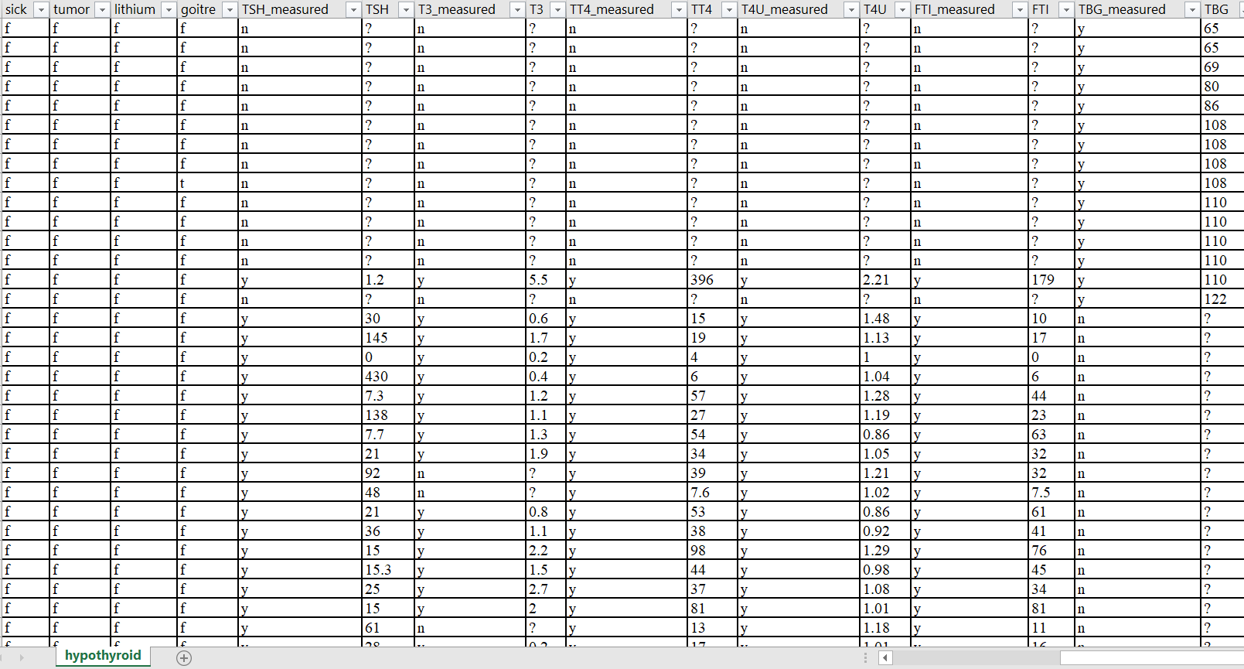
Dataset Snapshot-Second Half

Slide 8
Dataset Description [Attributes and Domain]
Class : Hypothyroid,Negative
on_thyroxine: f,t.
query_on_thyroxine: f,t.
on_antithyroid_medication: f,t.
thyroid_surgery: f,t.
query_hypothyroid: f,t.
query_hyperthyroid: f,t.
pregnant: f,t.
sick: f,t.
tumor: f,t.
lithium: f,t.
goitre: f,t.
sex: M,F,?.
age: continuous,?.

Slide 9
Dataset Description [Contd…]
TSH_measured: f,t.
TSH: continuous,?.
T3_measured: f,t.
T3: continuous,?.
TT4_measured: f,t.
TT4: continuous,?.
T4U_measured: f,t.
T4U: continuous,?.
FTI_measured: f,t.
FTI: continuous,?.
TBG_measured: f,t.
TBG: continuous,?.

Slide 10
Datapreprocessing Steps Contd…
We Downloaded the dataset ‘Hypothyroid.csv ’ from the datasource ‘UCI Machine Learning Repository’
Imported Libraries as required to work with the dataset
Load the Dataset
Dataset we used contains 3163 records and 26 attributes
Used pandas library to load dataset
Using this function pd.read_csv() we imported dataset

Slide 11
Datapreprocessing Steps Contd…
Handling missing data
By replacing missing values with 0,mean or median
The final chosen technique is mean in the best case
Removing outliers
We detected noisy data and removed them at each class level using quantile as measure
Class balancing
SMOTE is a class balancing technique which adds virtual records using K-Nearest Neighbours(KNN) internally.
NearMiss is a class balancing technique which removes records using K-Nearest Neighbours(KNN) internally
Splitting dataset
Split the dataset into train set and test set in the ratio 80:20
Train set was used to construct model using machine learning algorithms
The test set was used to verify model performance

Slide 12
Feature Selection Techniques
Feature selection enables the machine learning algorithms to train faster
It reduces the complexity of the model and makes it easier to interpret
Different Feature Selection Techniques Used:
Chi2 Test
This is a statistical measure used to find the influence of a caterogical attribute on class and the values that don’t influence class are dropped
RFECV
This selects the data using Random Forest as estimator, scoring measure as accuracy,Stratified Kfold as Cross Validator
This returns the optimal features to be used and hence we have chosen this to construct our final model
Info gain
This selects features based on calculated info gain
The high info gain the high important attribute is

Slide 13
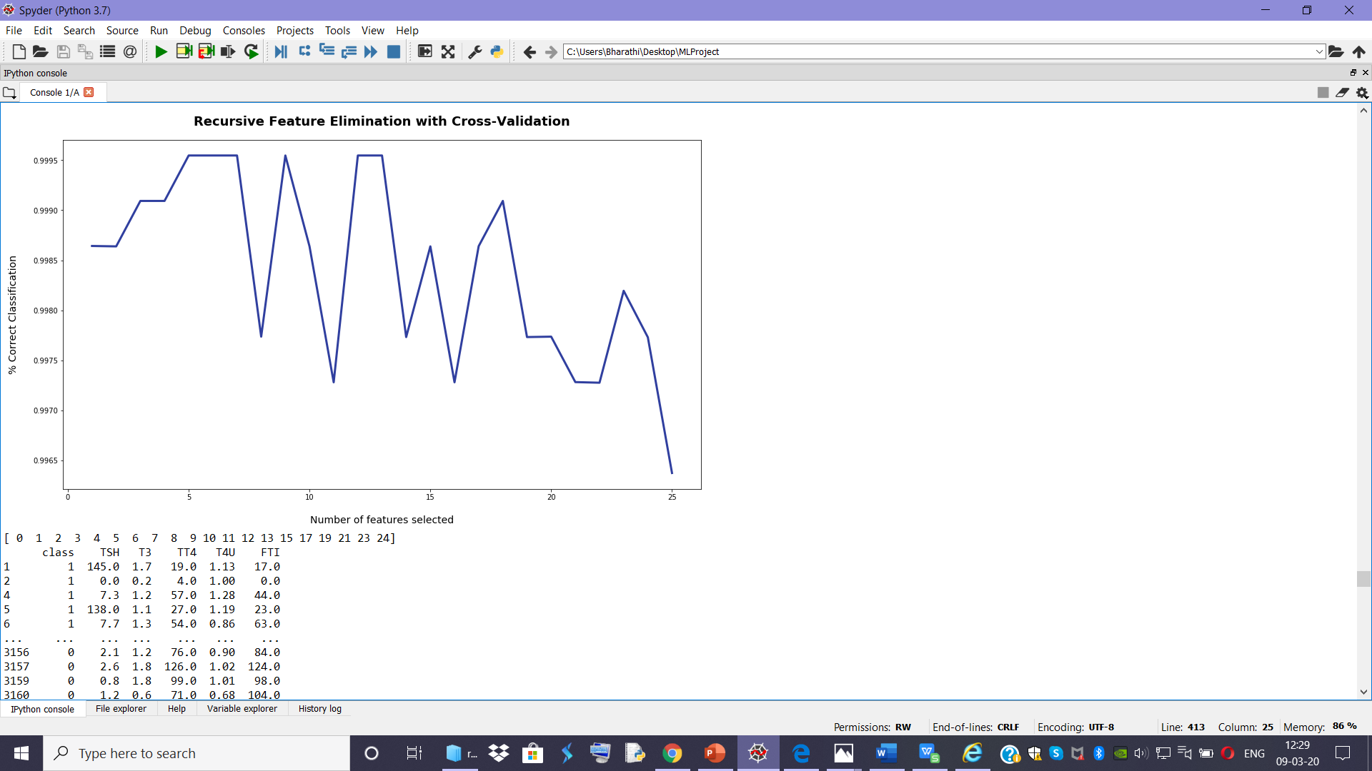
RFECV plot for optimal feature selection

Slide 14
Different Algorithms Used In Our Project
Logistic Regression
Support Vector Classifier
Random Forest Classifier
K Nearest Neighbours
Gausian Naive Bayes
Decisiion Tree Classifier

Slide 15
Description of Algorithms
Logistic Regression
Support Vector Classifier
Logistic Regression is a Machine Learning algorithm which is used for the classification problems, it is a predictive analysis algorithm and based on the concept of probability.
The hypothesis of logistic regression tends it to limit the cost function between 0 and 1
A Support Vector Machine (SVM) is a discriminative classifier formally defined by a separating hyperplane.
Using labeled training data (supervised learning), the algorithm outputs an optimal hyperplane which categorizes new examples.

Slide 16
Description of Algorithms Contd…
Random Forest Classifier
Random forest, like its name implies, consists of a large number of individual decision trees that operate as an ensemble.
Each individual tree in the random forest spits out a class prediction and the class with the most votes becomes our model’s prediction
Multiple decision trees are generated each time and best is selected hence it’s accuracy is high
This is the best fit algorithm for the model we have chosen to work with our dataset after comparitive analysis

Slide 17
Description of Algorithms Contd…
K Nearest Neighbours
An object is classified by a plurality vote of its neighbors, with the object being assigned to the class most common among its k nearest neighbors (k is a positive integer, typically small).
We used k = 5, then the object is signed to the class of that five nearest neighbors.
It is a lazy learning algorithm.

Slide 18
Description of Algorithms Contd…
Decision Tree Classifier
Gausian Naïve Bayes
Decision Trees are a type of Supervised Machine Learning where the data is continuously split according to a certain parameter.
The tree can be explained by two entities, namely decision nodes and leaves. The leaves are the decisions or the final outcomes.
And the decision nodes are where the data is split.
A Gaussian Naive Bayes algorithm is a special type of NB algorithm. It's specifically used when the features have continuous values.
It's also assumed that all the features are following a gaussian distribution i.e, normal distribution

Slide 19
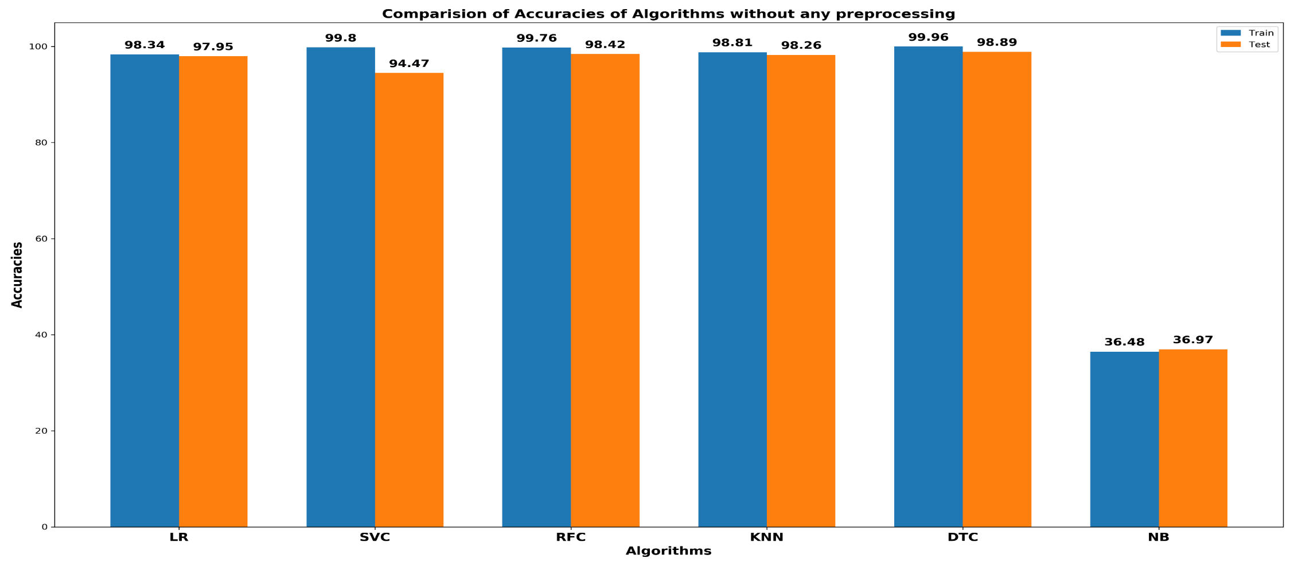
Before Preprocessing

Slide 20
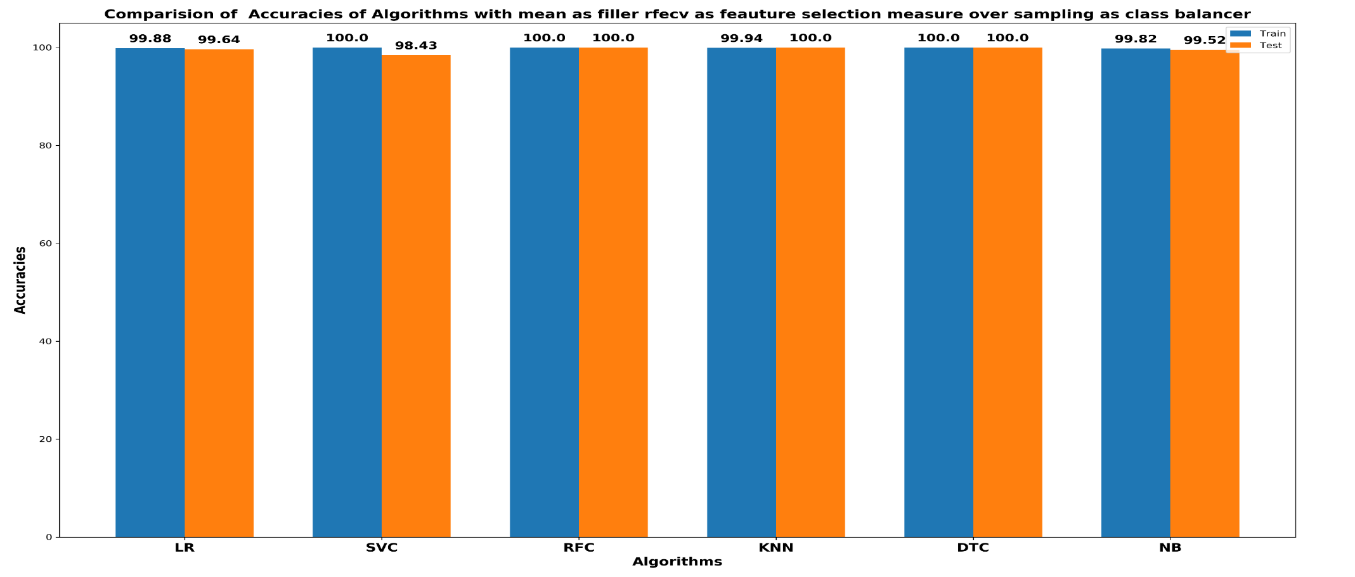
Mean Filler RFECV Over Sampling

Slide 21
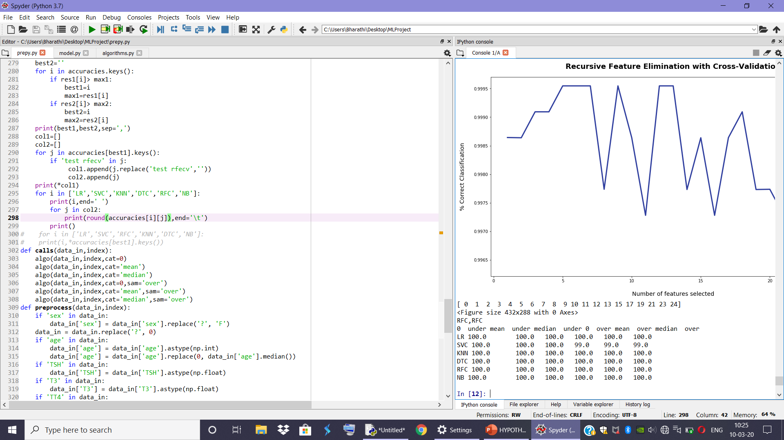
Comparision of algorithms test accuracy with RFECV as Feature Selection Technique

Slide 22
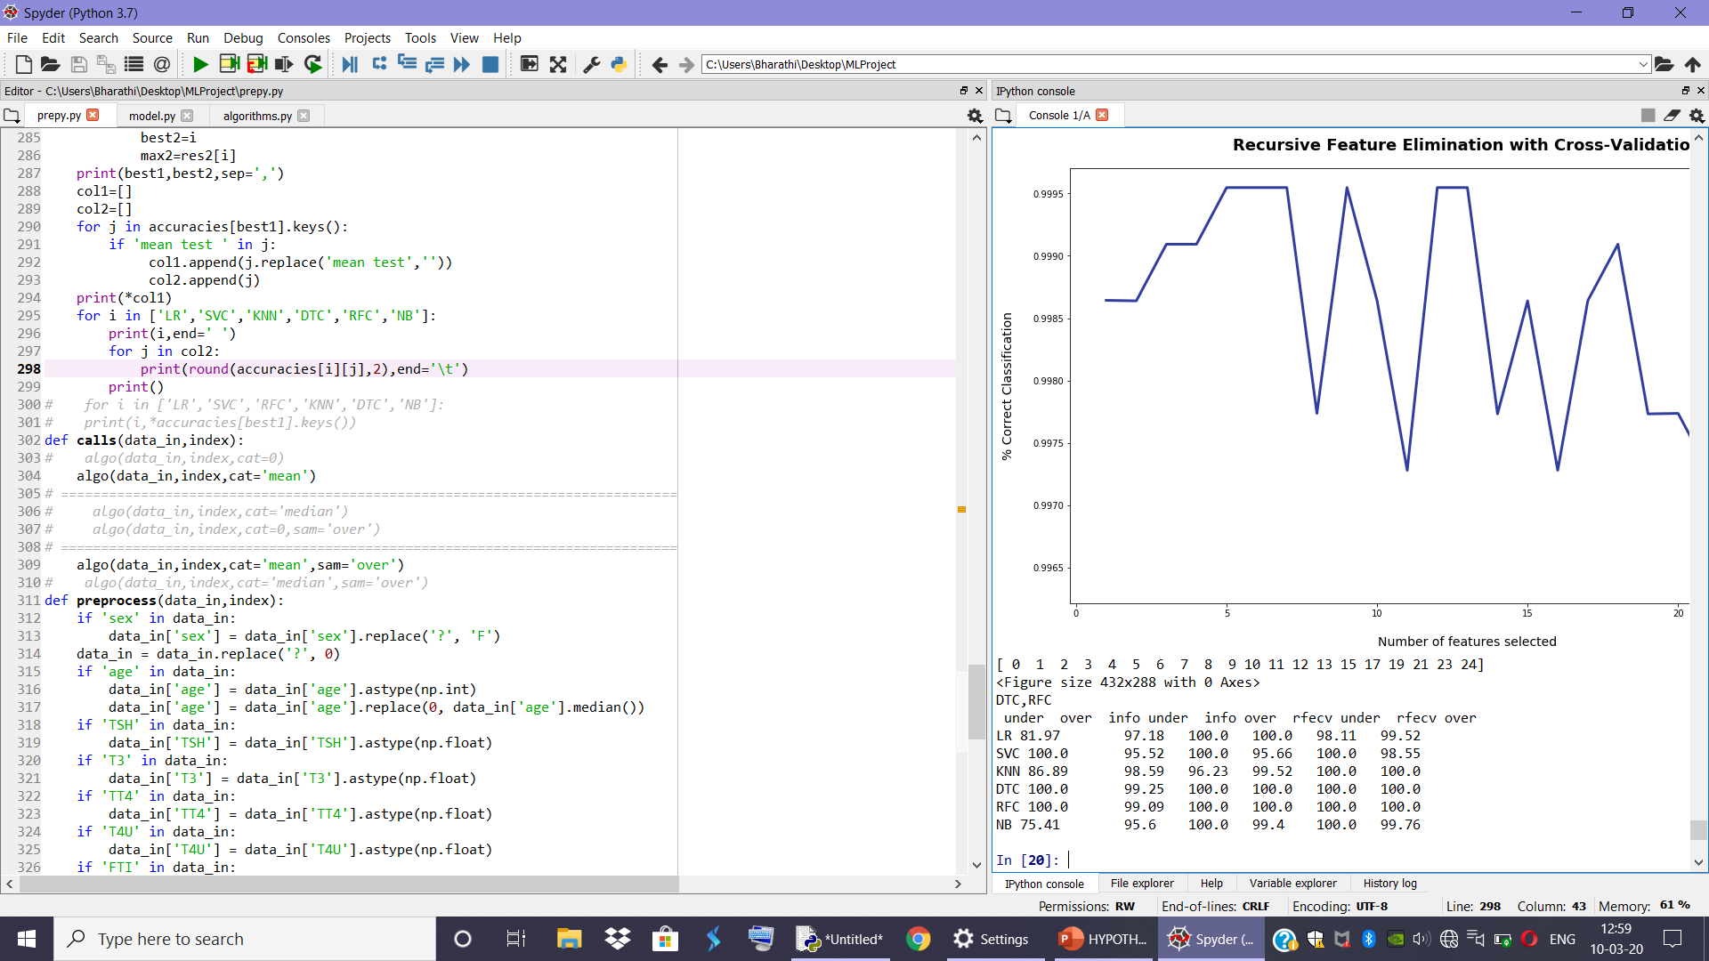
Comparision of algorithms test accuracy with Mean for Null values

Slide 23
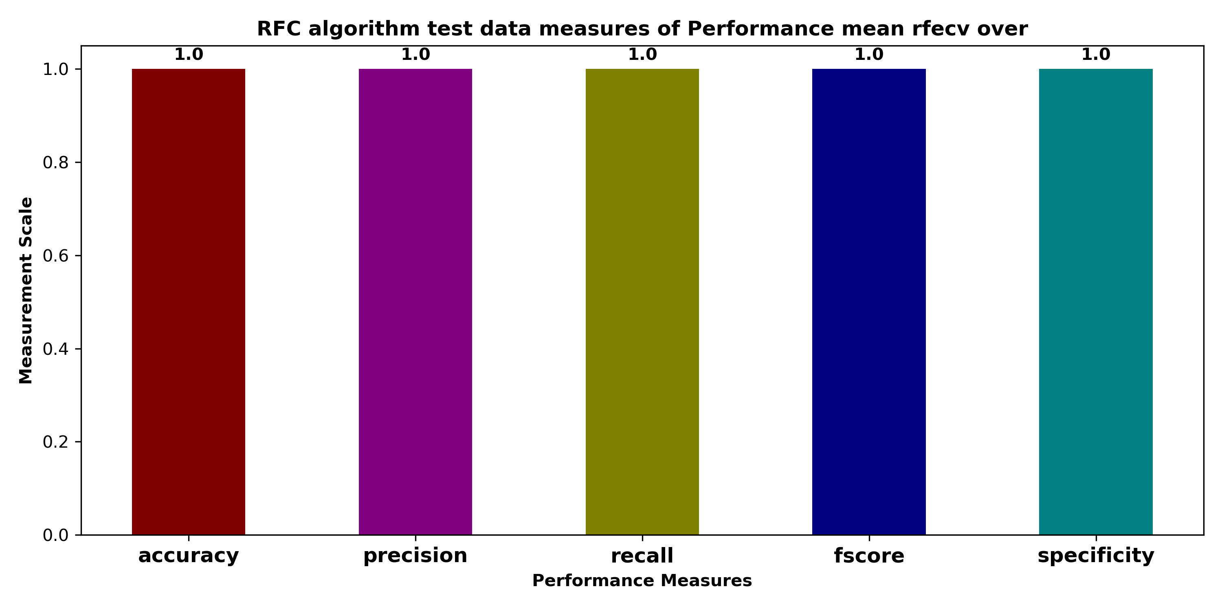
Performance Metrics of RFC Algorithm TEST with SMOTE

Slide 24
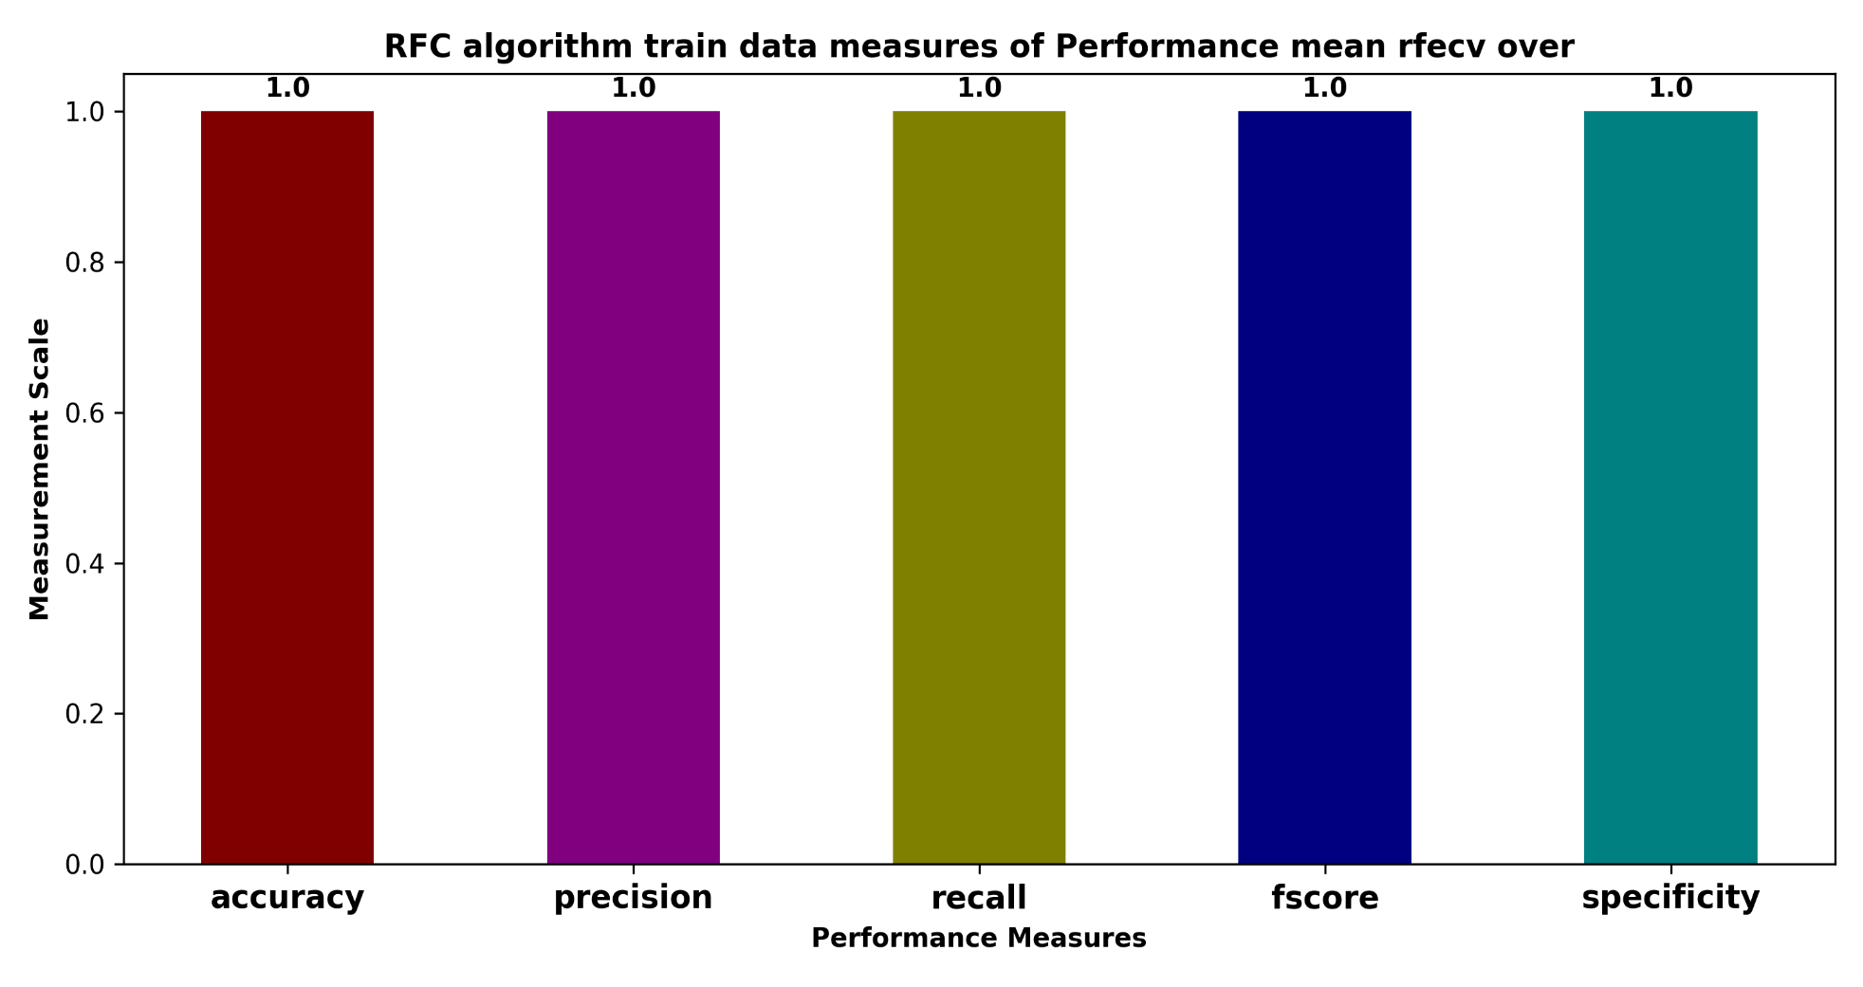
Performance Metrics of RFC Algorithm TRAIN with SMOTE

Slide 25
Conclusion
We derived the conclusion that mean replacement of missing data,rfecv as feauture selection mechanism RFC with SMOTE for class balancing gives the best accuracy.
SMOTE for class balancing improves the precision for the ‘Hypothyroid’ class and the prediction is atmost accuracate for all the class labels.

Slide 26
Future Scope
In future , the application can be enhanced to predict the edge cases having a risk of disease but currently not uncovered.
The application can be enhanced by providing preventive measures and steps to follow to maintain hormone levels

Slide 27
Online References
https://www.javatpoint.com/data-preprocessing-machine-learning
https://towardsdatascience.com/building-a-logistic-regression-in-python-step-by-step-becd4d56c9c8
https://towardsdatascience.com/understanding-confusion-matrix-a9ad42dcfd62

Slide 28
THANK YOU…

